Slide 1
The United Kingdom of Great Britain and Northern Ireland

Slide 2
Round 1
Geography

Slide 3
How many parts is The UK divided into? What are they?
4 parts
England
Scotland
Wales
Northern Ireland

Slide 4
Round 2
Literature

Slide 5
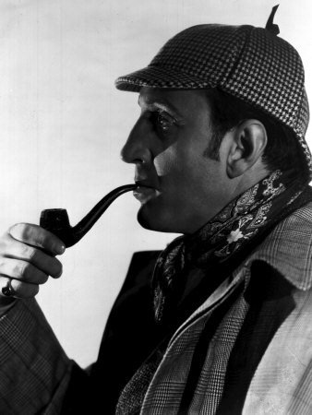
Who lived in 221b,Baker street?
Sherlock Holmes

Slide 6
Who is the most famous woman-writer of detective stories?
Agatha Christie

Slide 7
Who is the author of books about Harry Potter?
J. K. Rowling

Slide 8
Round 3
Inventions

Slide 9
Who invented the first phone?
Alexander Graham Bell

Slide 10
What is the name of the physicist who opened lots of laws in physics?
Isaac Newton

Slide 11
What is the name of the British scientist who invented the theory of evolution?
Charles Darwin

Slide 12
Round 4
Traditional food

Slide 13
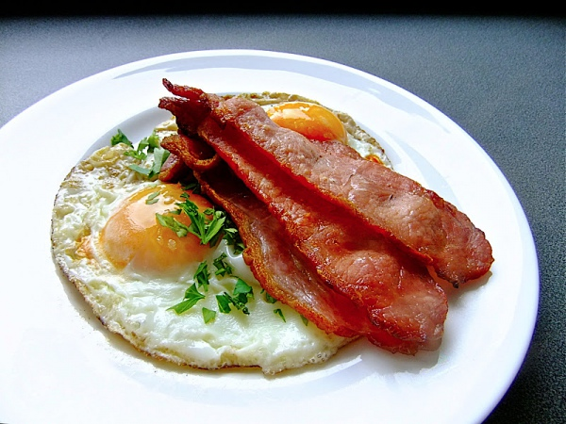
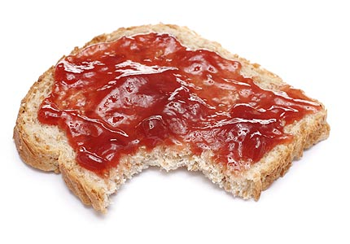
What do British people always have for breakfast?
Bacon and fried eggs
Porridge
Toasts with marmalade

Slide 14
As you know, tea is a traditional English drink. What do they takes with it?
Tea with milk

Slide 15
What is favourite British dish?
Fish and chips

Slide 16
Round 5
Sights

Slide 17
What is it?
Big Ben

Slide 18
What is it?
The Tower Bridge

Slide 19
What is it?
Stonehenge

Slide 20
What is it?
Westminster Palace

Slide 21
Thanks for your attention!

