Slide 1
Some advice how to solve conflicts

Slide 2
If the sentence is true, repeat it. If it is false, correct it:
You and your brother get on well.
You never shout at you younger sister.
Your relatives can resolve conflicts peacefully.
You shouldn’t listen to other people.
You are always polite.
You don’t want to learn about conflicts resolution.
You have fights with your friends every day.
You often ignore your friend’s opinion.

Slide 3
Look at the picture and listen to the recording

Slide 4
Say what the quarrel is about and answer the questions:
Chris told his brother to give him the remote control. What did Tom say? What did Chris answer?
The mother told Chris to give the remote to his brother. Why? What did she say? What did the father think about it?
Do such conflicts often happen in families?

Slide 5
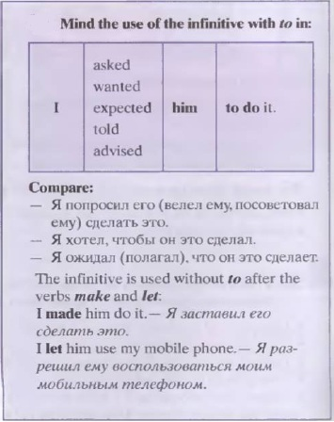

Slide 6
Make up the sentences using the given words and phrases

Slide 7
Work in pairs. Make up a dialogue between Ann Smith and the editor Mr Hanks
Use:
To live in peace
Decide what the children should do
Help the children prevent/ resolve conflicts
Decide what the problem is
Suggest an idea
Discuss
Choose
Put into action

