Slide 1
Modal Verbs

Slide 2
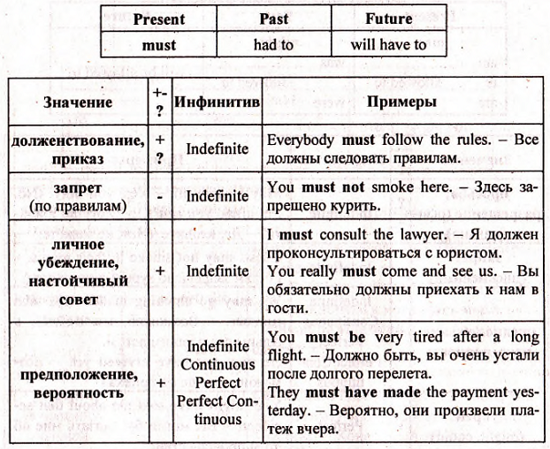
Must \ mustn’t

Slide 5
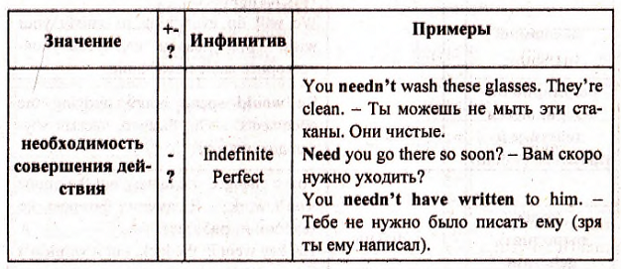
Need \ needn’t

Slide 6
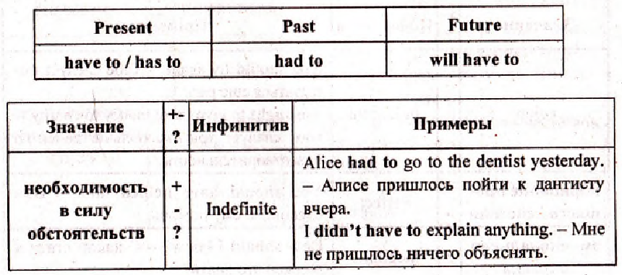
Have to has to Haven’t to hasn’t to

Slide 7
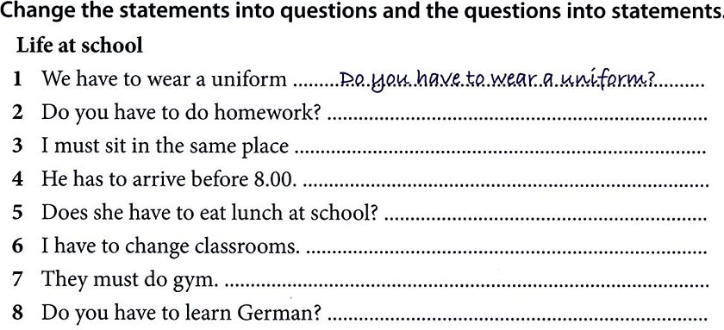

Slide 8
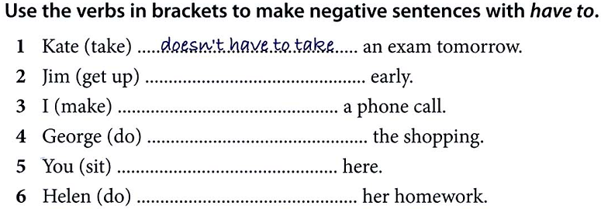

Slide 9
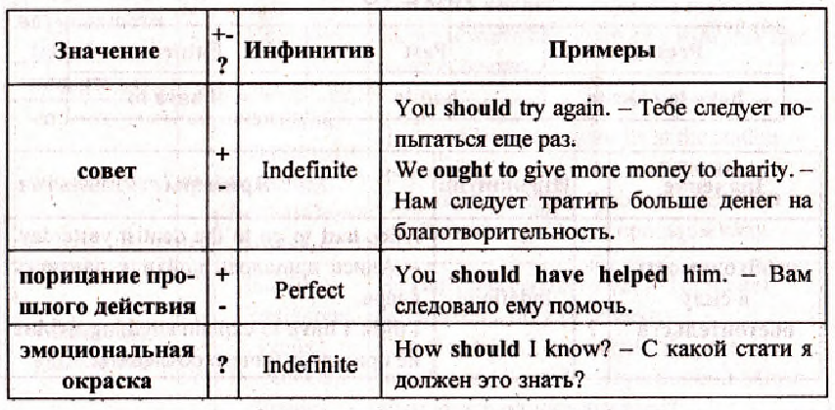
Should \ shouldn’t

Slide 10
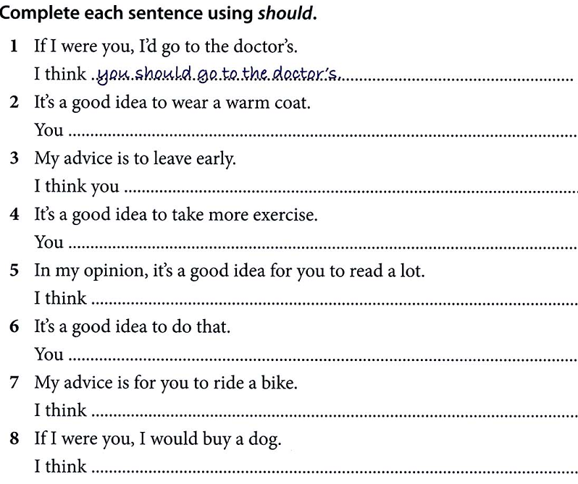

Slide 11
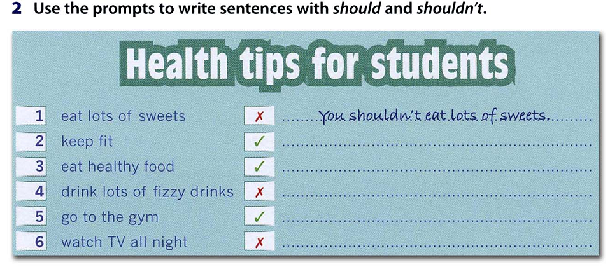

Slide 12
Translate into Russian

Slide 13
